Slide 1

Trees of Copenhagen
Social data analysis and visualization
Project assignment A
Notes:
Hej Andreas, håber du kan lide powerpointet. Du er så heldig at få lov til at vælge forsiden :D
Kan du bedst lide denne?

Slide 2
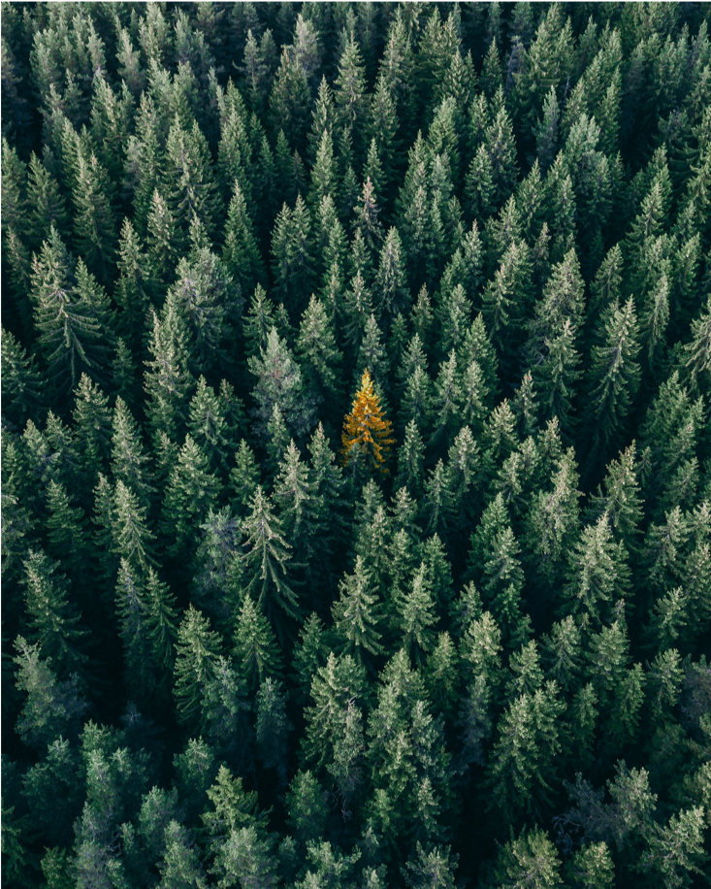
Trees of Copenhagen
Social data analysis and visualization
Project assignment A
Notes:
Eller denne her?

Slide 3
Agenda
Idea
Visualization
Elements needed
Implementation plan
Preliminary data-analysis

Slide 4
Idea
Inspiration from website
Tree data of Copenhagen
Help the city-planner or citizens
https://www.cloudred.com/labprojects/nyctrees/
Notes:
An explanation of the central idea behind your final project (what is the idea? which datasets do you need to explore the idea?, why is it interesting?)
Inspiration from an website displacing the trees in five neighbourghood in NY. So we want to make the same over CPH. Right now we have two datasets, of different sizes and with different features. (Choose one or merges?). It is interesting to see want we can find in the data. What patterns will reveal itself?
Be ready to safe the trees from corona.

Slide 5
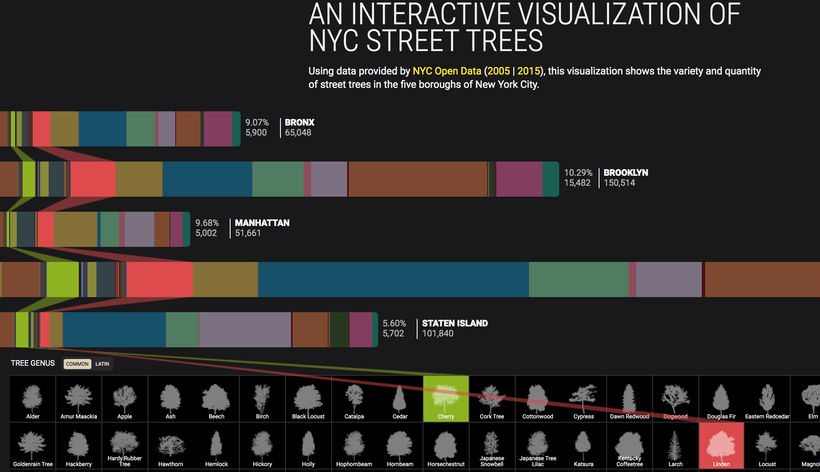

Slide 6
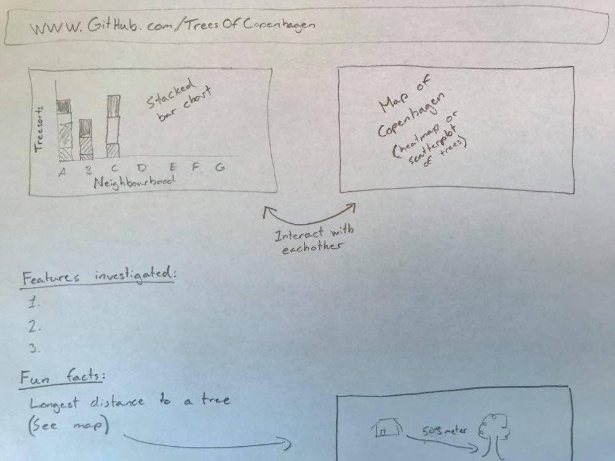
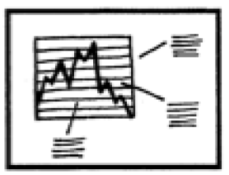
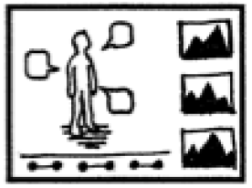
Visualization
Genre:
+
Notes:
Our goal is to build a website that is easy to interact with and display how the trees are distributed across the neighbourhoods of Copenhagen.
Genre: A mix between an Annotated chart and Partitioned poster, it suits good to our data and the ideas we have about tell a story of the trees in CPH. Great to explain the count analysis we will primary do.

Slide 7
Elements needed
Obtain the skills for combining interactive plots
Understanding how to host on Github
Exporting plots to HTML

Slide 8


Implementation plan
Preliminary Data analysis
Creating interactive plots
Converting to HTML
Hosting on Github.com

Slide 9
Preliminary data-analysis
Two data sets, one is contained within the other.
5.9 MB and 52.5 MB
Dataset 1:
19956 rows
28 features
Dataset 2:
59580 rows
183 features (Most of which are empty)

Slide 10
Data features
The most important features are:
Type of tree
District
Location (Coordinates)

Slide 11
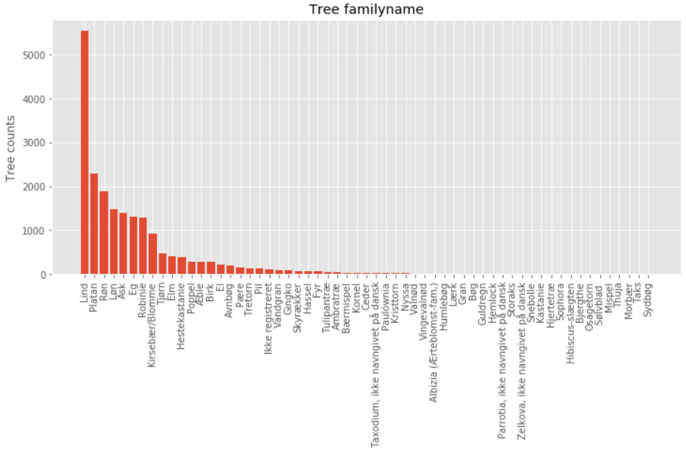
Most common trees

Slide 12
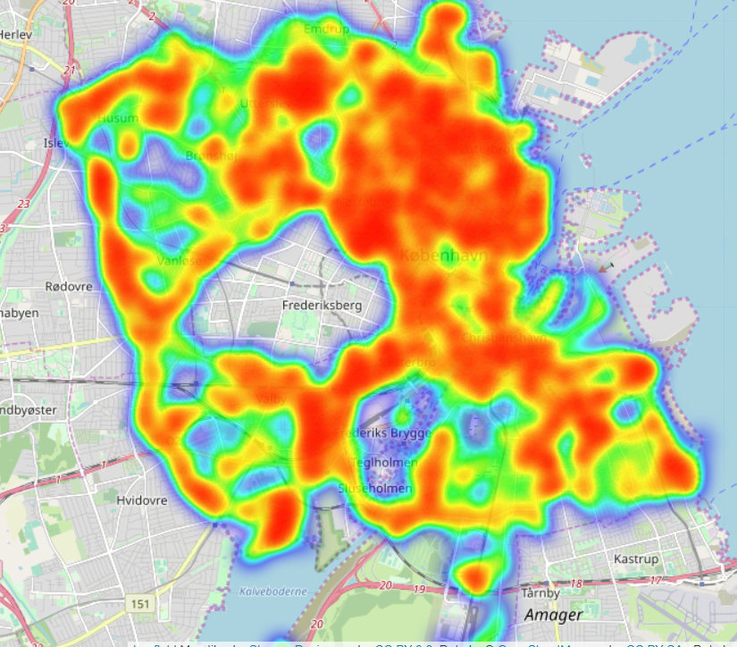
Heat map of all trees

Slide 13
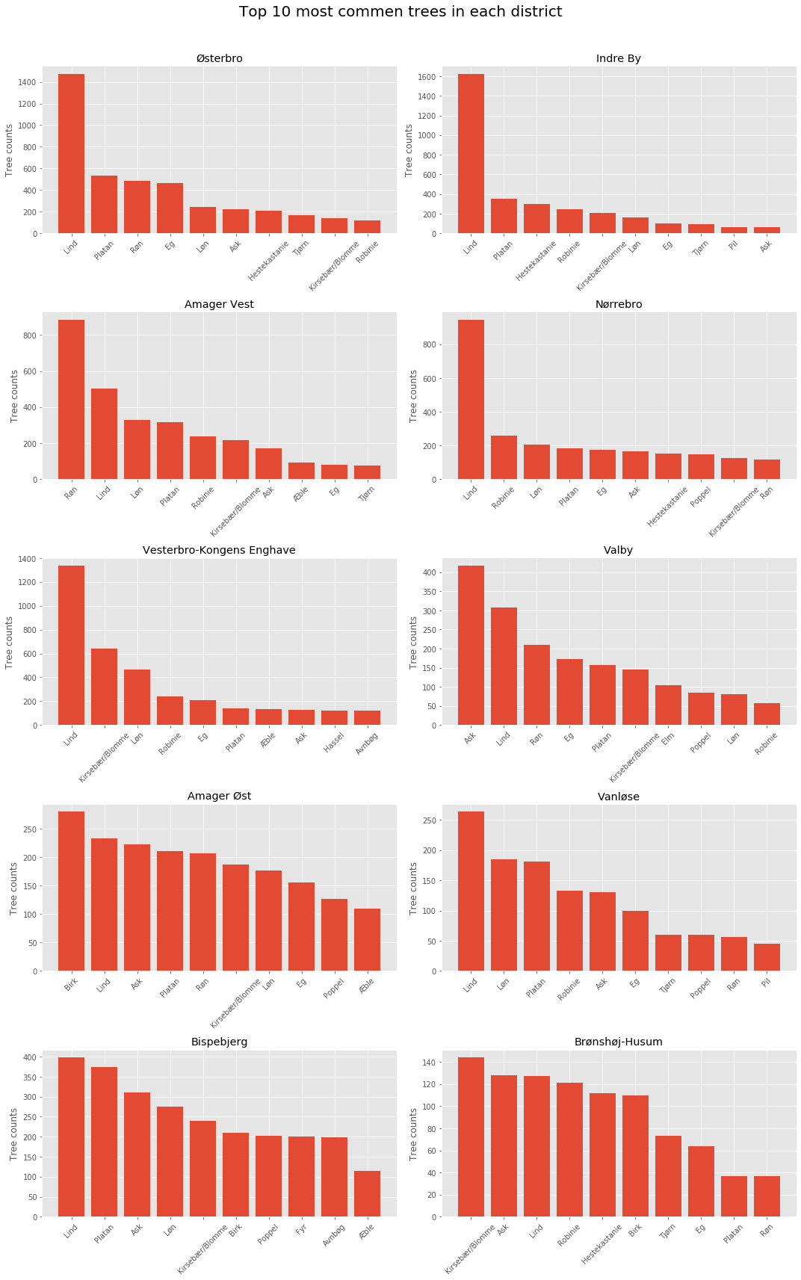
Most common trees in each district

